Slide 1

Sighing on the Dotted Line
Nehemiah 9:38–10:39
Rick Griffith • Crossroads International Church • BibleStudyDownloads.org

Slide 2
Black

Slide 3
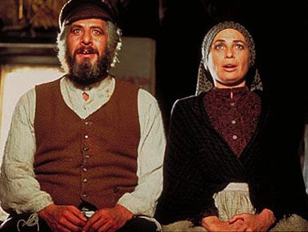
“Do you love me?”

Slide 4
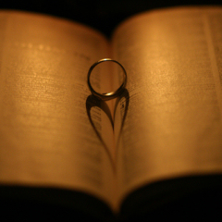

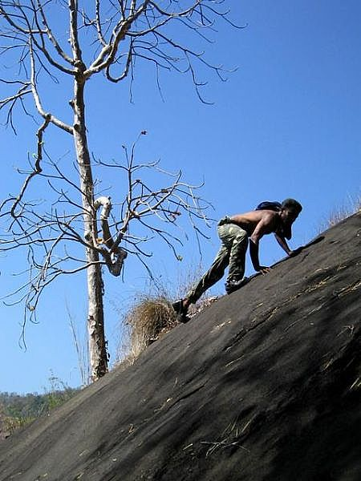
Commitment

Slide 5
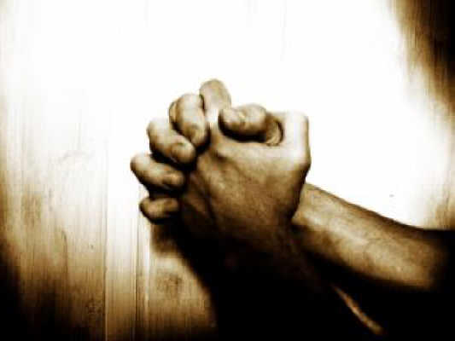
Romans 12:1 NAU
“Therefore I urge you, brethren, by the mercies of God, to present your bodies a living and holy sacrifice, acceptable to God, which is your spiritual service of worship.”

Slide 6
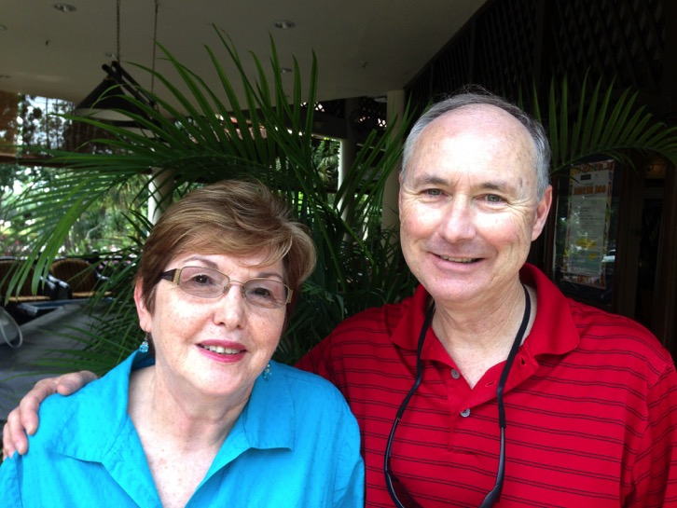
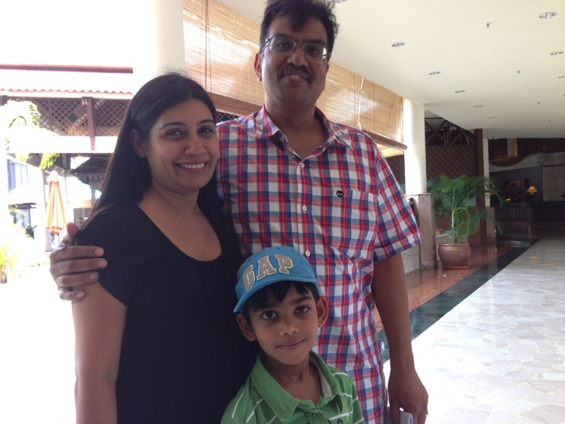
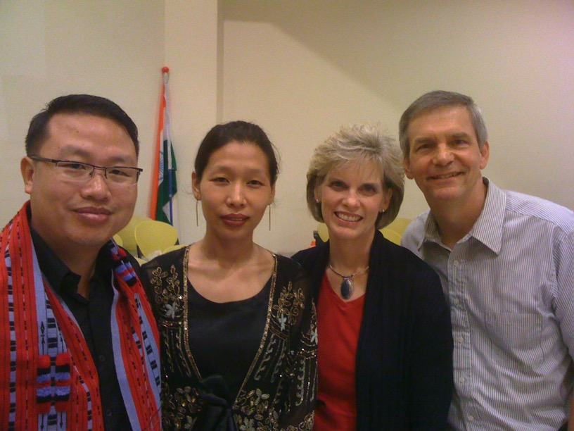
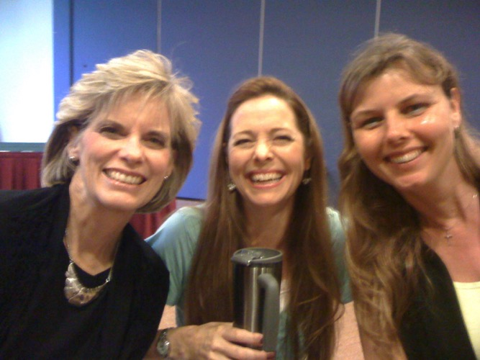
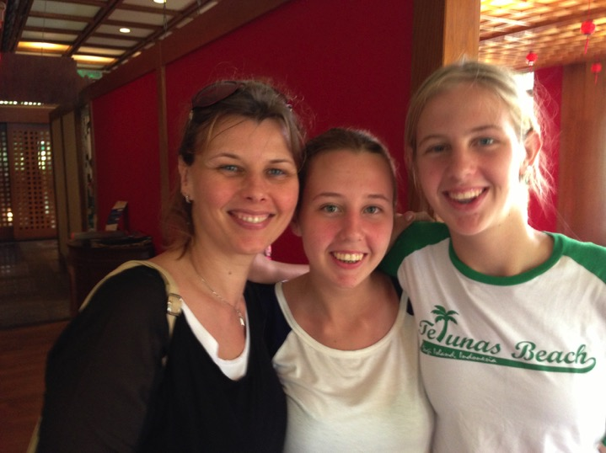
How should our church renew our commitment to God?
Crossroads International Church

Slide 7
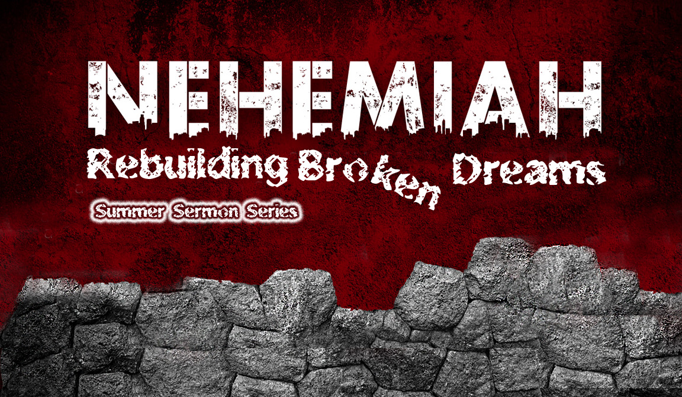
Our Present Sermon Series
July-October 2013

Slide 8
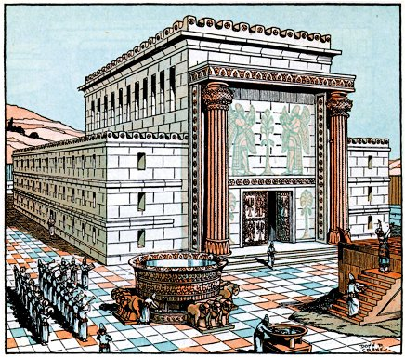
The temple stood unprotected without city walls
Notes:
8

Slide 9
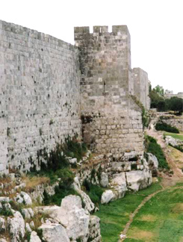
Completed in 52 days!

Slide 10
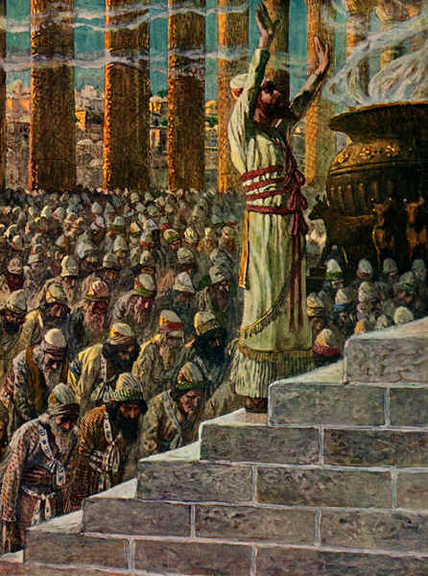
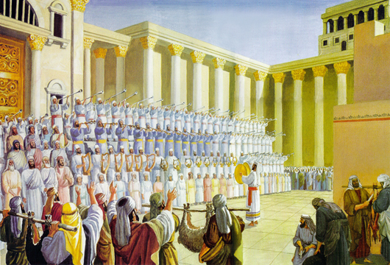
Covenant Renewal
Notes:
10

Slide 11

Community Renewal
Nehemiah 8–10
Nehemiah 10
Nehemiah 9
Nehemiah 8
COVENANT
CONFESSION
CONVICTION

Slide 12
I. Leaders must lead in commitment to God (9:38–10:27).
Community Renewal
Nehemiah 8–10
Nehemiah 10
COVENANT
I. Leaders

Slide 13
Black

Slide 14

Signers of the Covenant
• Civil: Nehemiah & Zedekiah (1b)
• Religious: Priests (2-8)
• Religious: Levites (9-13)
• Civil: Other leaders of the tribes (14-27)

Slide 15

B. Leaders
Leaders show their commitment to God by committing to those they lead

Slide 16

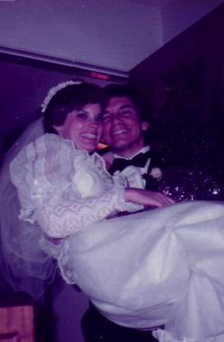
7 Vows in My Life
Marry only a Christian (age 16)
Remain a virgin until marriage (age 16)
Drive the speed limit the rest of my life (age 17)
Read the Bible 5 minutes every day (age 19)
Never divorce my wife Susan (age 25)
Never be sexually unfaithful to Susan (age 25)
Never say “no” to a place God leads me (age 25)

Slide 17
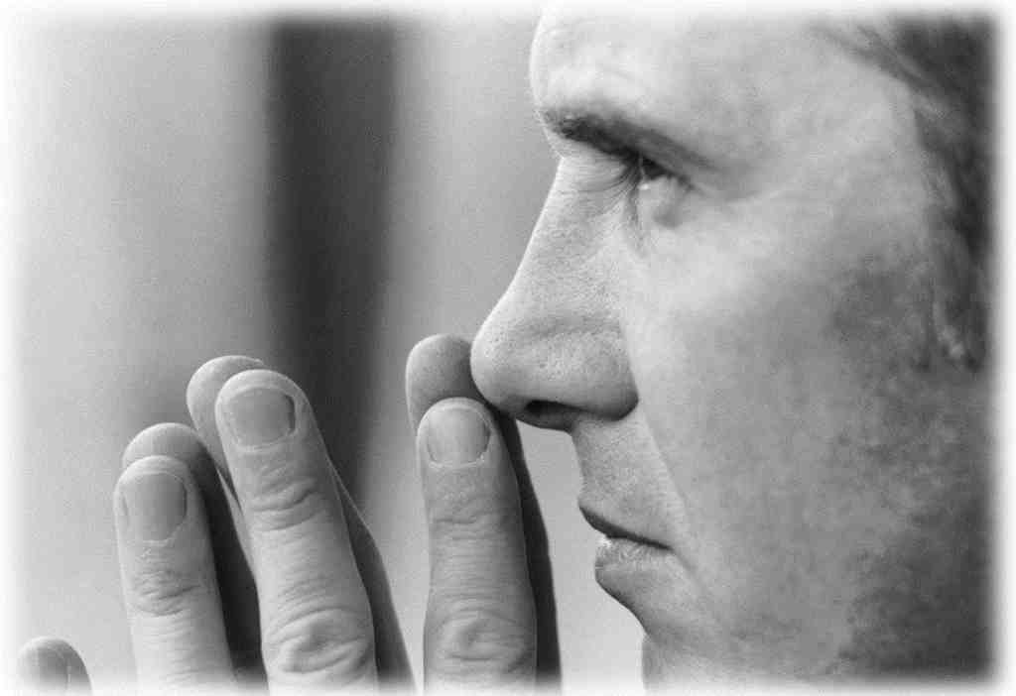
Expectations of CIC Elders
Attend 6 months
Service
Members

Slide 18
Black

Slide 19
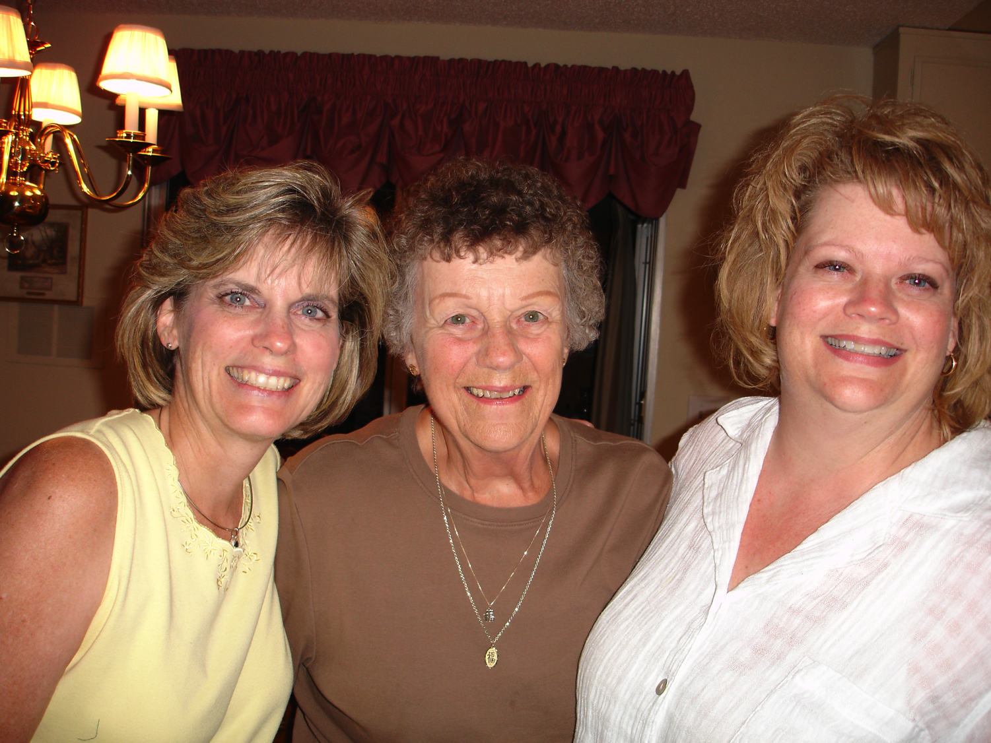
Susan's Mom

Slide 20
II. Followers must follow in committing to God (10:28-29).
Community Renewal
Nehemiah 8–10
Nehemiah 10
II. Followers
COVENANT
I. Leaders must lead in committing to God (9:38–10:27).
I. Leaders

Slide 21
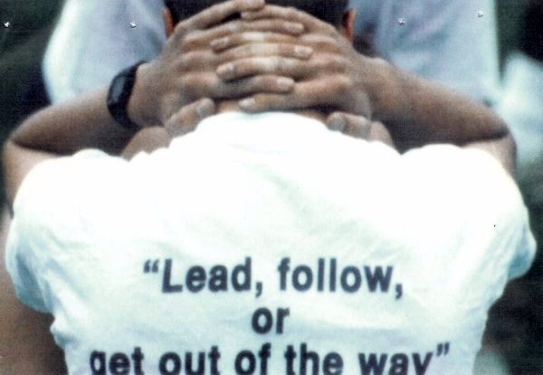

Slide 22
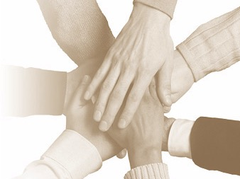
The People's Commitment
1. Separation & Obedience (28-29)
2. No intermarriage (30)
3. Sabbath (31)
4. Support Temple (32-39)
• Tax (32-33)
• Firstfruits (35-37a)
• Wood (34)
• Tithes (37b-39)

Slide 23
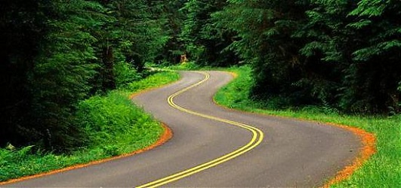
B. Followers show commitment to God…
by committing to those who lead them.

Slide 24

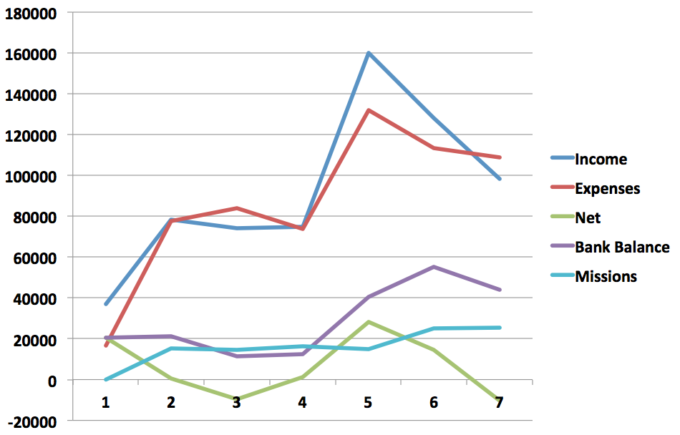
Finances 2007-2013
07
08
09
10
11
12
13

Slide 25

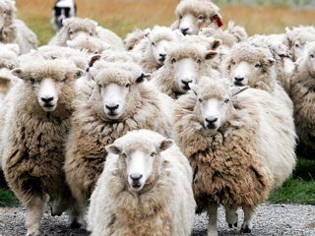
Balance is Needed…

Slide 26
Sighing on the Dotted Line
Nehemiah 9:38–10:39

Slide 27
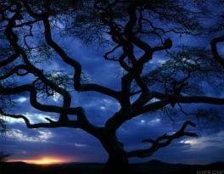
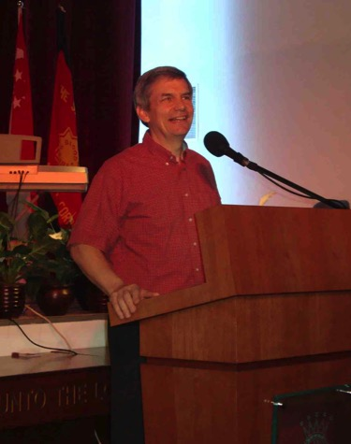
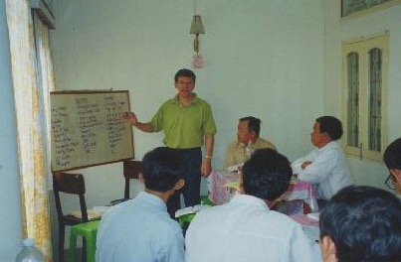
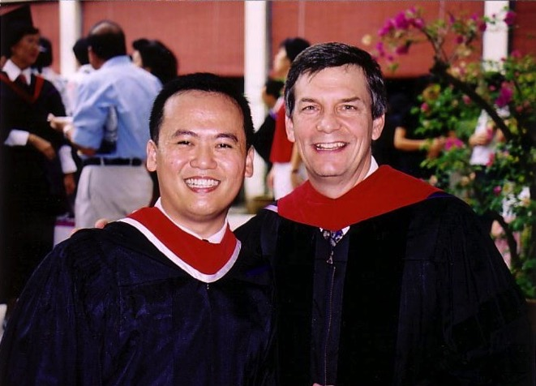


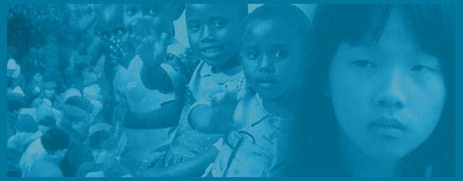
Our Ministry Tree
Itinerate Teaching
Crossroads
International Church
Singapore Bible College
WorldVenture
Notes:
27

Slide 28
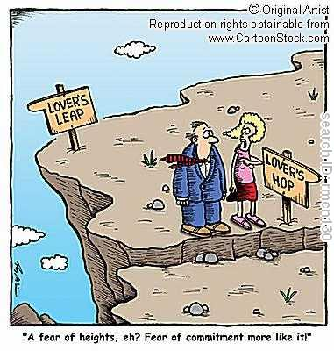
"A fear of heights, eh?
Fear of commitment more like it!"

Slide 29


Signing on the Dotted Line

Slide 30
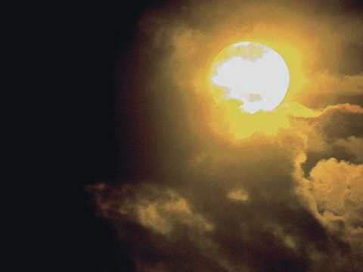
Our Church Covenant
Notes:
30
30
We begin with reminding ourselves that we are in a covenant relationship with God, so we likewise should be covenanted with one another.

Slide 31
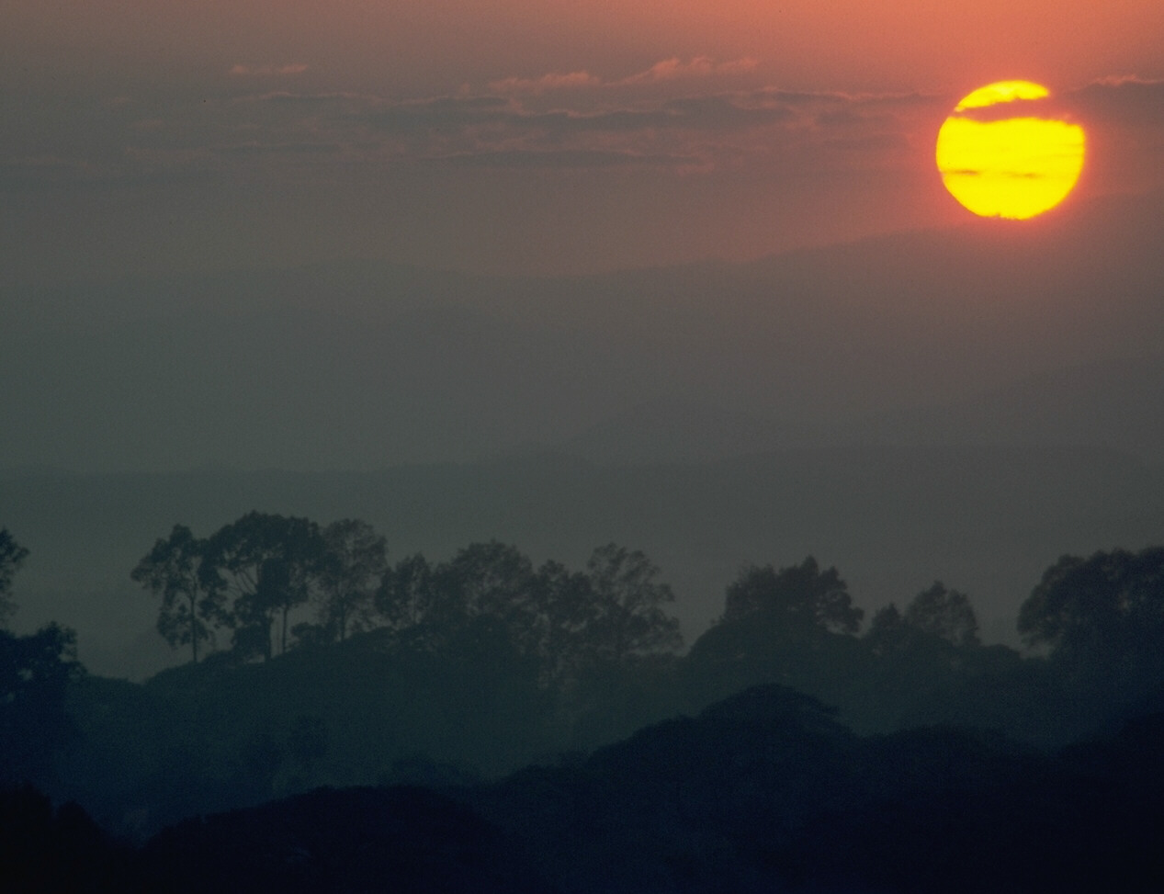
Voting Members…
❒ subscribe fully to the Doctrinal Statement
❒ commit to uphold the Church Covenant
❒ are Singapore Citizens or Singapore Permanent Residents or holders of Employment Passes or Dependant Passes or Student Passes or Work Permits issued by the relevant authorities in Singapore
❒ are born-again believers and are above twenty-one (21) years of age [a government limitation; youth are non-voting]
❒ are actively ministering in the Church; and
❒ signify their willingness to co-operate and participate in the work and ministries of the Church to attain the objectives of the Church and to contribute their support to the Church regularly
Notes:
31
31
For future votes, we are accepting voting members today--as well as some youth who are non-voting. Requirements are the same for both, except that youth cannot by law vote. [Read above.]

Slide 32
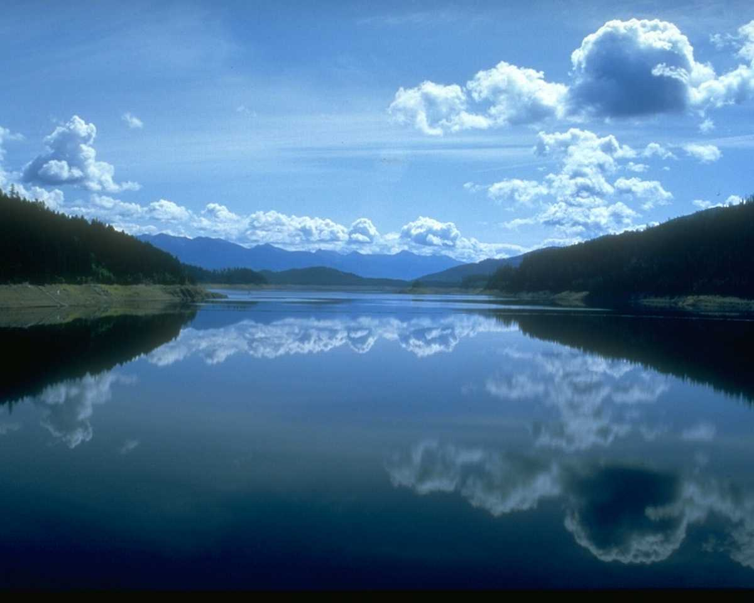
Covenant 1 of 5
We, the members of
CROSSROADS INTERNATIONAL CHURCH LTD.,
attest that we have received Jesus Christ as Savior and Lord and have submitted to believer's baptism, and that we have voluntarily joined the CROSSROADS INTERNATIONAL CHURCH LTD and pledged to abide by the provisions of this covenant with the help of the Holy Spirit.
Notes:
32
32
Let us commit together…

Slide 33
Covenant 2 of 5
As members of one body, we pledge to:
guard its doctrinal purity defined in the Doctrinal Statement
uphold the Constitution and abide by its provisions
support its mission of making disciples of all nations
participate in its evangelistic, educational, and edifying programs through faithful attendance and financial support
Notes:
33
33

Slide 34
Covenant 3 of 5
respect its duly constituted leadership
preserve its organizational and spiritual unity
submit to the standard of New Testament church discipline
love and serve one another according to Christ's example
provide financial support to CIC willingly and cheerfully as God has prospered us
Notes:
34
34

Slide 35
Covenant 4 of 5
maintain a personal program of spiritual development through prayer and Bible study
engage in personal witnessing for Christ in word and deed
uphold a high standard of morality in personal, public, business, and family life
abstain from habits and activities which are harmful to the body, binding to the will, damaging to Christian witness, and not glorifying to God
Notes:
35
35

Slide 36
Covenant 5 of 5
resolve all conflicts with arbitration only among believers without recourse to the secular courts
bear one another's burdens, rejoice with those who rejoice, sympathize with those who hurt, and encourage the weak
be slow to take offense, quick to secure reconciliation, and show consideration of the personal convictions of other members; and
transfer our membership to a church with practices similar to these, which we now uphold, when we move to another place
Notes:
36
36

Slide 37
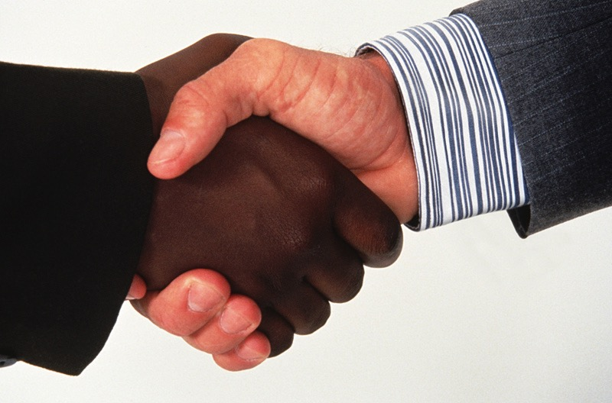
New Members?
Notes:
37
37

Slide 38
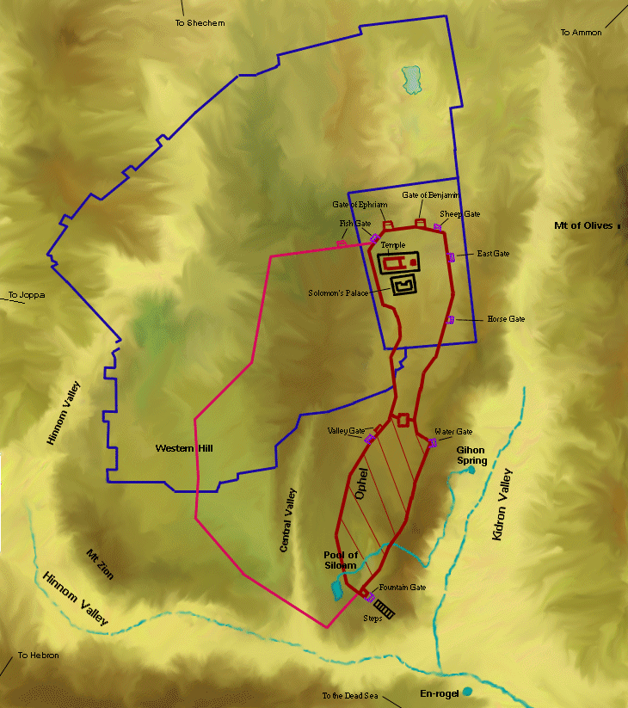
Wall-to-Wall Workers (Neh 3:31-32)
304
³¹Malkijah, one of the goldsmiths, repaired the wall as far as the housing for the Temple servants and merchants, across from the Inspection Gate. Then he continued as far as the upper room at the corner. ³²The other goldsmiths and merchants repaired the wall from that corner to the Sheep Gate.
Tower of Hananel
Tower of 100
Mount of Olives
Sheep Gate
Fish Gate
Inspection Gate
Jeshanah (Old Gate?)
East Gate
Broad Wall
Horse Gate
Tower of the Ovens?
Wall of Ophel
Great Projecting Tower
Valley Gate
Water Gate
Dung Gate
The Angle
Pool of Shelah (Siloam)
Fountain Gate
Notes:
38

Slide 39


Our Crossroads Wall in September 2013
MEN
MISSIONS
EVANGELISM
• Leland
• ?????
• Albina • Singpu • Désirée
PREACHING
HOME GROUPS
• Rick
• Lewis
• Singpu
FINANCES
MUSIC
• Valentin
• Rick
• Athan
• David
• Susan
• Jieun
• Miriam
• Athan
• Singpu
• Shannah
• Tessa
• Cynthia
WOMEN
• Susan
• Désirée
• Linda Fones
WEBSITE & AV
• Andrew
• Drew
YOUTH
NURSERY
LOGISTICS
• Yaopei
• Athan
• Chanchan
KIDS
• Singpu
• David
• Athan
• Kim
• Kim
• Chanchan
Notes:
Building the wall together are 19 of us in leadership. Not bad considering that our church has 32 adults! Yet I'm an idealist so I'd like to see 100% involvement though!
2013: 19 of 32
2009: 28 of 46

Slide 40


YOU are needed NOW!
Treasurer
Evangelism
Missions Coordinator
Nursery Coordinator
Downstairs Greeter
Greeters
Ushers
AV Assistant
Drummer
griffith@sbc.edu.sg

Slide 41
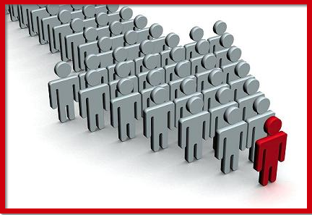
Leaders must lead…
How should our church renew our commitment to God?
…and followers must follow
Crossroads International Church

Slide 42
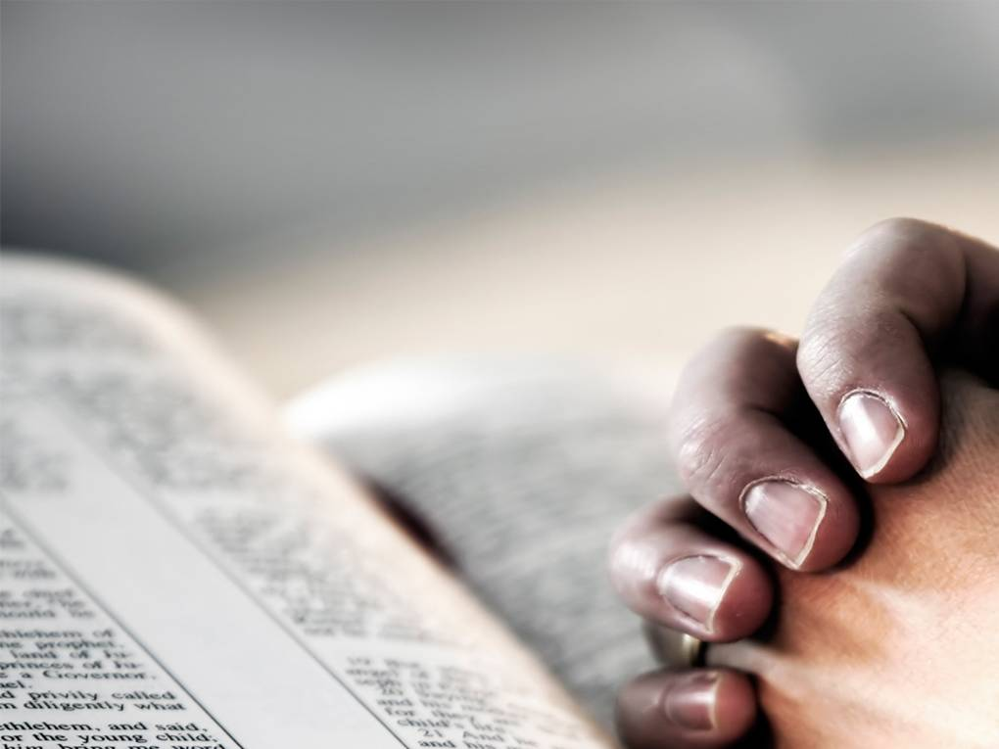
What to Do?
• Are you a member?
• What's your role?

Slide 43
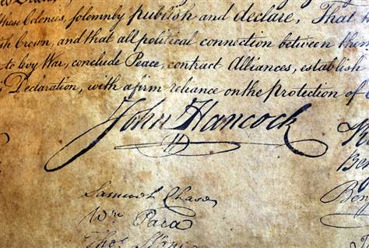
Declaration of Independence

Slide 44
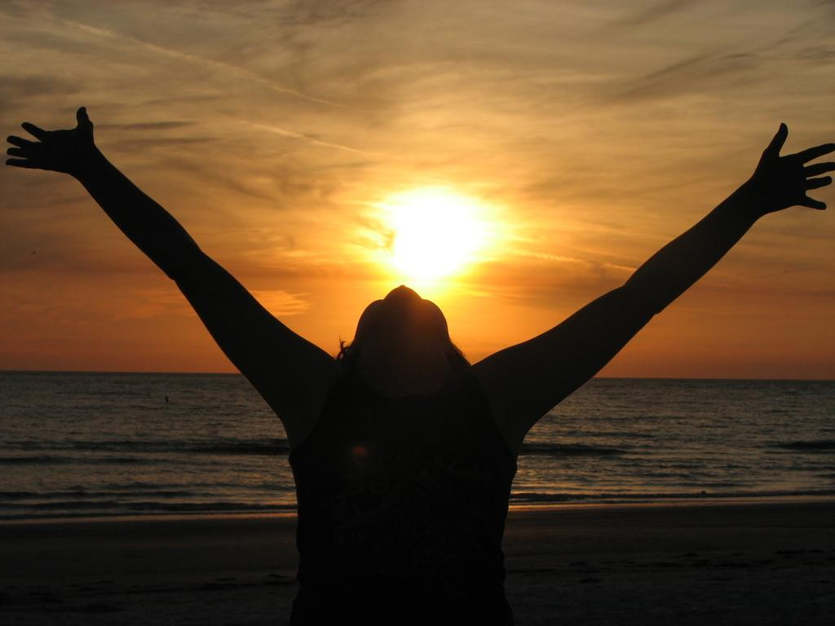
Declaration of Dependence

Slide 45
Black

Slide 46


OT Preaching link at BibleStudyDownloads.org
Get this presentation for free!
Notes:
OT Survey (os)

